Slide 1

Statistical Analysis of Team Performance Data
Lakshay Girdher Anmol Garg

Slide 2

Introduction
NOTE:
To change images on this slide, select a picture and delete it. Then click the Insert Picture icon
in the placeholder to insert your own image.
Methods used:
1. Two-Way ANOVA + Tukey’s HSD + Barplots – For comparing means across groups with two factors. 2. Chi-Square Test of Independence – For testing relationships between categorical variables. 3. Time Series Analysis + Moving Averages + Exponential Smoothing – For trend and forecast analysis.

Slide 3
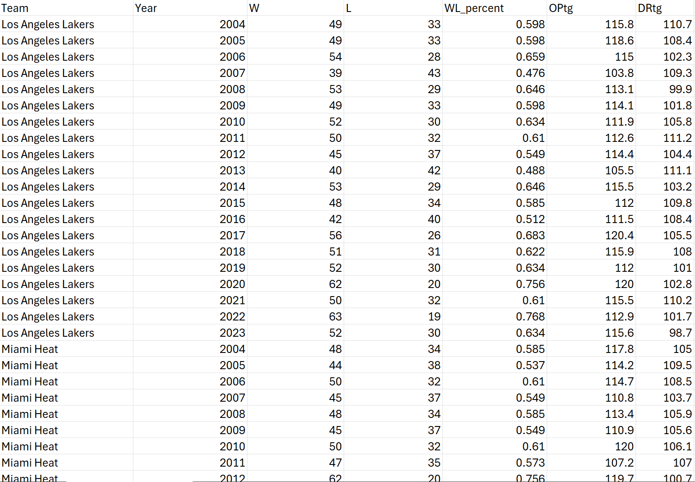
Dataset Overview
Contains team performance data (Boston Celtics, Golden State Warriors, Los Angeles Lakers, Miami Heat) Key variables:
1. OPtg – Offensive rating (points scored per 100 possessions)
2. YearF – Year factor (multiple seasons)
3. High/Low category – Classification based on performance thresholds

Slide 4


Two-Way ANOVA Overview
Tukey’s HSD:
Tests for differences between means across two factors
A post-hoc test to identify exactly which groups differ.
Hypotheses:
H₀A: No difference between Factor A means.
H₀B: No difference between Factor B means.
H₀AB: No interaction between factors.
Decision rule: If p < α, reject null hypothesis.
Use interaction plots to visualize factor effects.

Slide 5
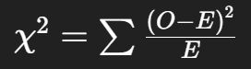
Chi-Square Test of Independence
Tests for independence between two categorical variables.
observed frequencies with expected frequencies.
Decision: If p < α, reject H₀ → variables are related.
Test statistic:
Compares Null Hypothesis (H₀): The variables are independent.
Alternative Hypothesis (H₁): The variables are dependent (associated).
Key Output: Chi-square statistic, degrees of freedom, and p-value.

Slide 6
Moving Average Method
Used to smooth short-term fluctuations and highlight long-term trends.
Common in time series forecasting.
Choice of n affects smoothness:
larger n → smoother but slower response.
Types:
1. Simple
2. Weighted
3. Centered
Formula for Simple Moving Average: SMAt = Sum of last n values/n

Slide 7

Time Series + Exponential Smoothing
Time Series Analysis:
Exponential Smoothing:
Observes patterns over time (trend, seasonality, noise).
Assigns decreasing weights to older observations for more responsive forecasts.

Slide 8

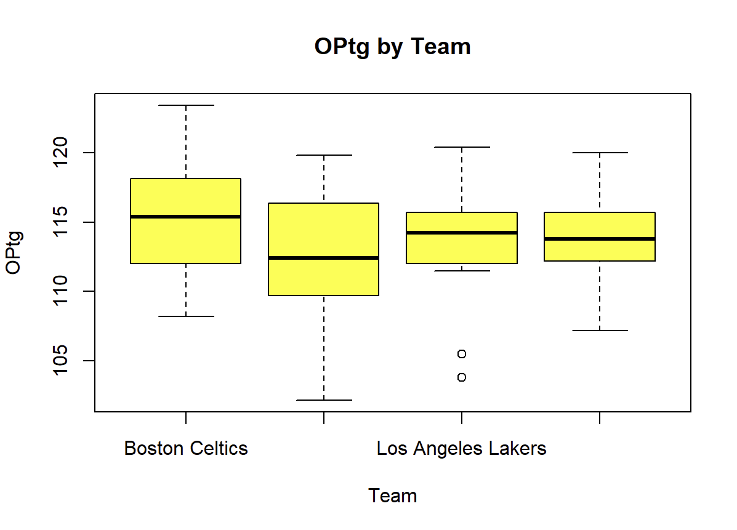
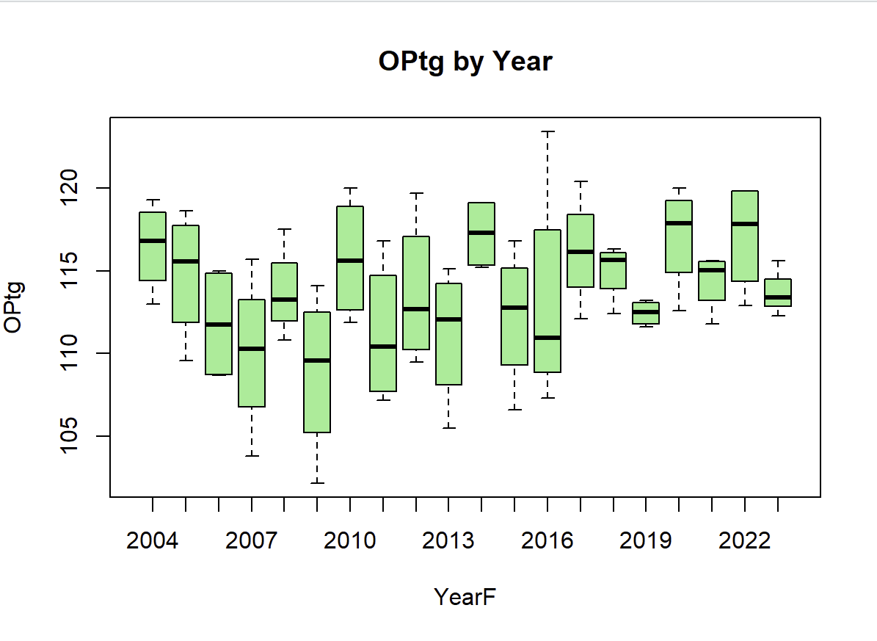
Applying Two-Way ANOVA + Tukey + Barplots
Selected dependent variable and two factors
Performed TWO-WAY anova
Conducted Tukey’s HSD
Created Barplots

Slide 9

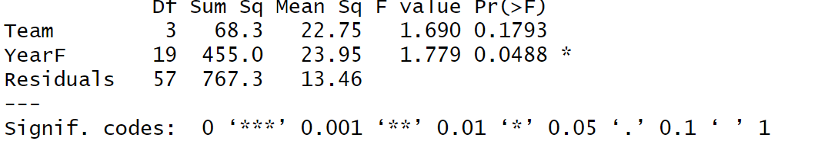
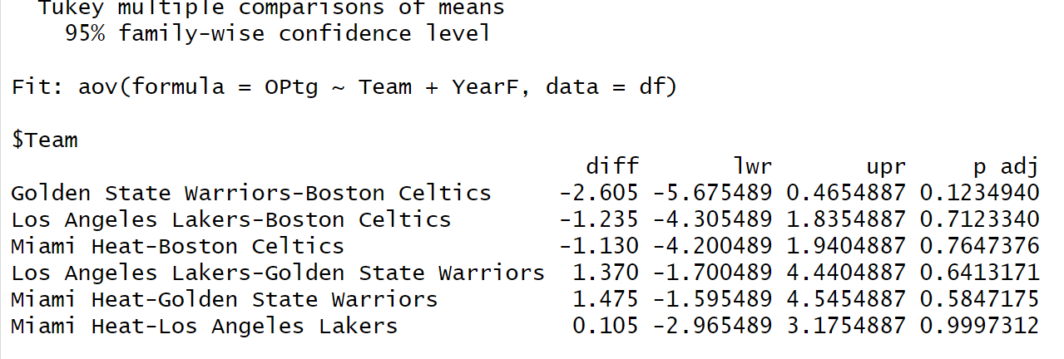
Results:
Interpretation:
Anova table
p-value < 0.05 → significant difference between group means.
Tukey HSD:
No statistically significant differences in OPtg between any teams (all p > 0.05).
Confidence intervals for all comparisons include 0.
Small numerical differences are likely due to random variation.

Slide 10

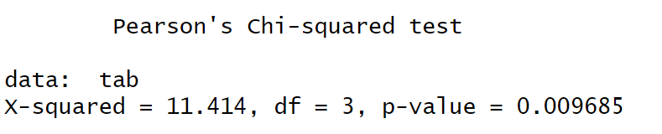
Applying Chi-Square Test of Independence
Steps Taken:
Selected two categorical variables.
Created a contingency table.
Applied Chi-Square test.
Results:
Interpretaion:
p-value (0.0097) < 0.05 → Significant association exists between the variables.
The variables are not independent.

Slide 11
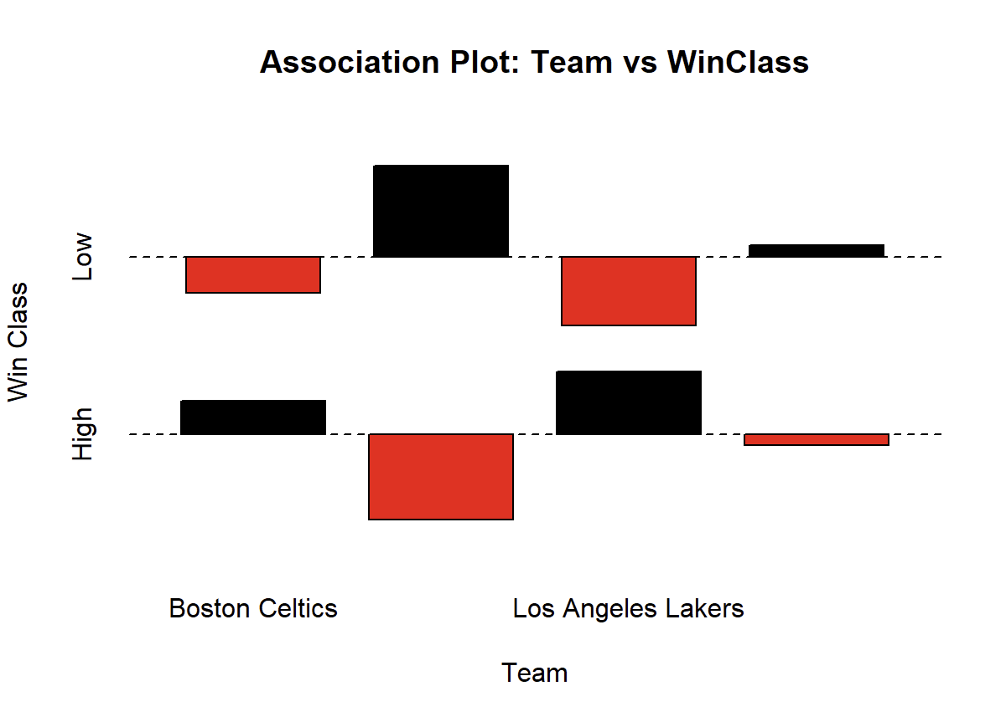
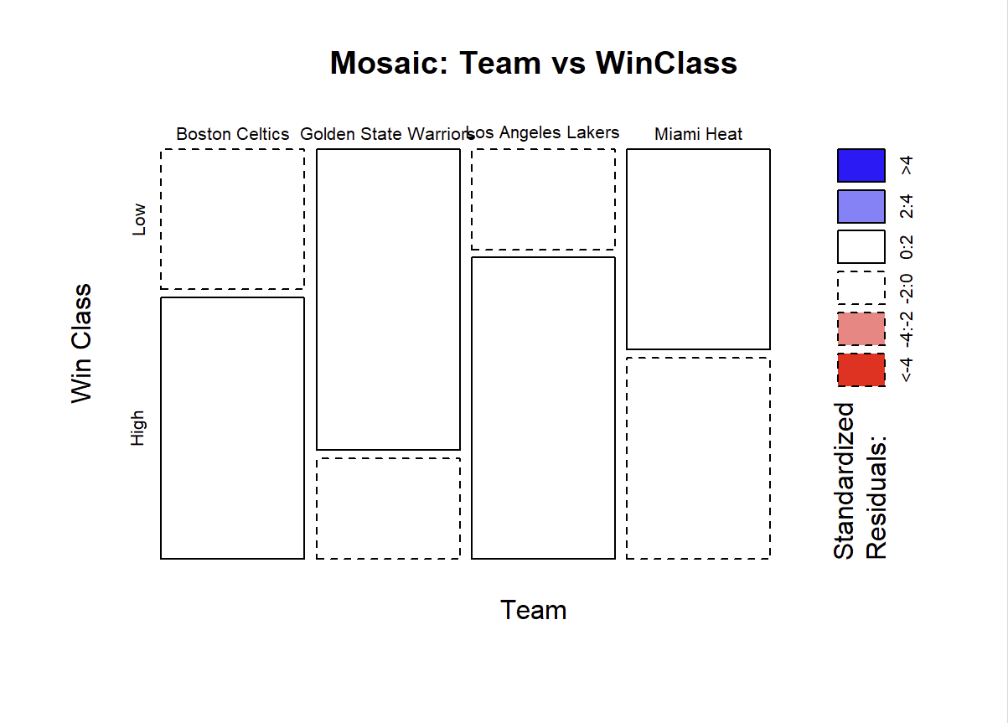
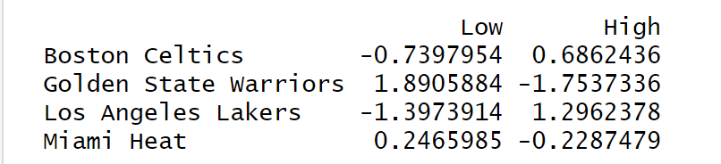
Association plot:
Bars above zero → higher-than-expected frequency.
Bars below zero → lower-than-expected frequency.
Example: Lakers have more “High” wins than expected, while Boston Celtics have fewer.
Mosaic plot:
Golden State Warriors tend to have more low-win seasons and fewer high-win seasons than expected.
Los Angeles Lakers lean towards more high-win seasons than low-win seasons.
Boston Celtics and Miami Heat show no strong deviations from expected win class distribution.

Slide 12
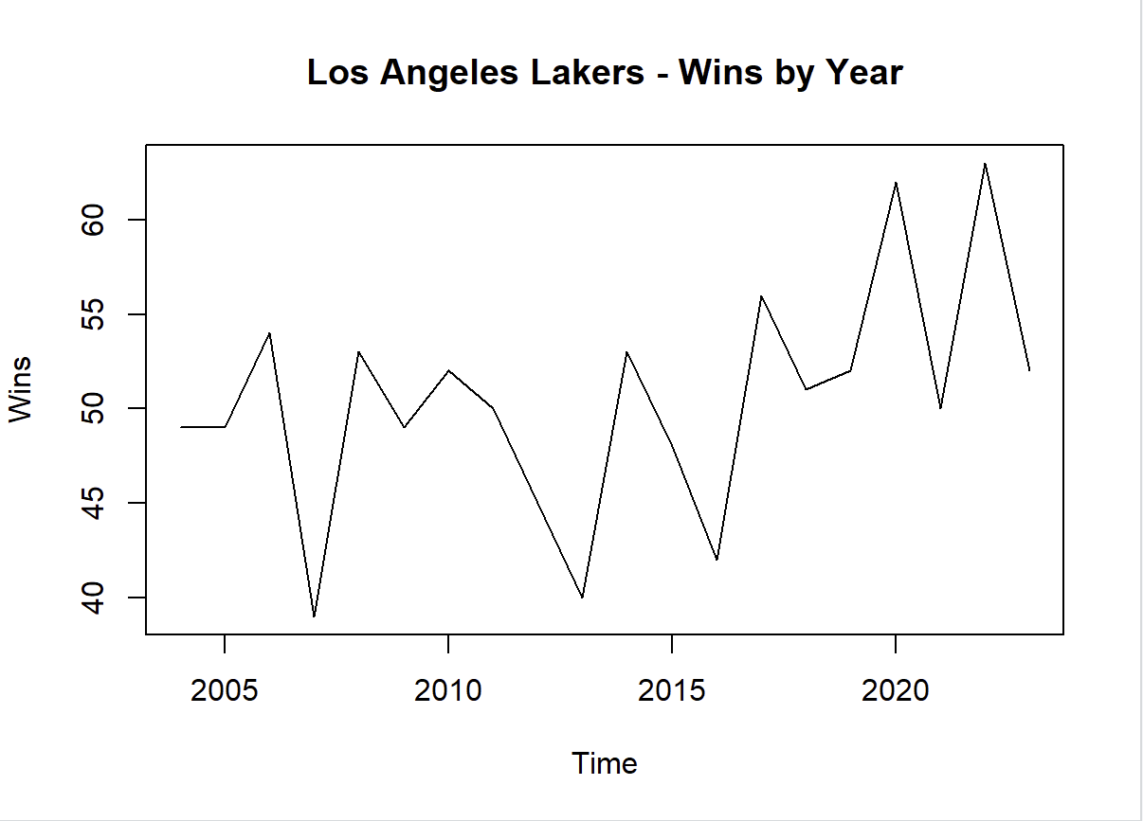
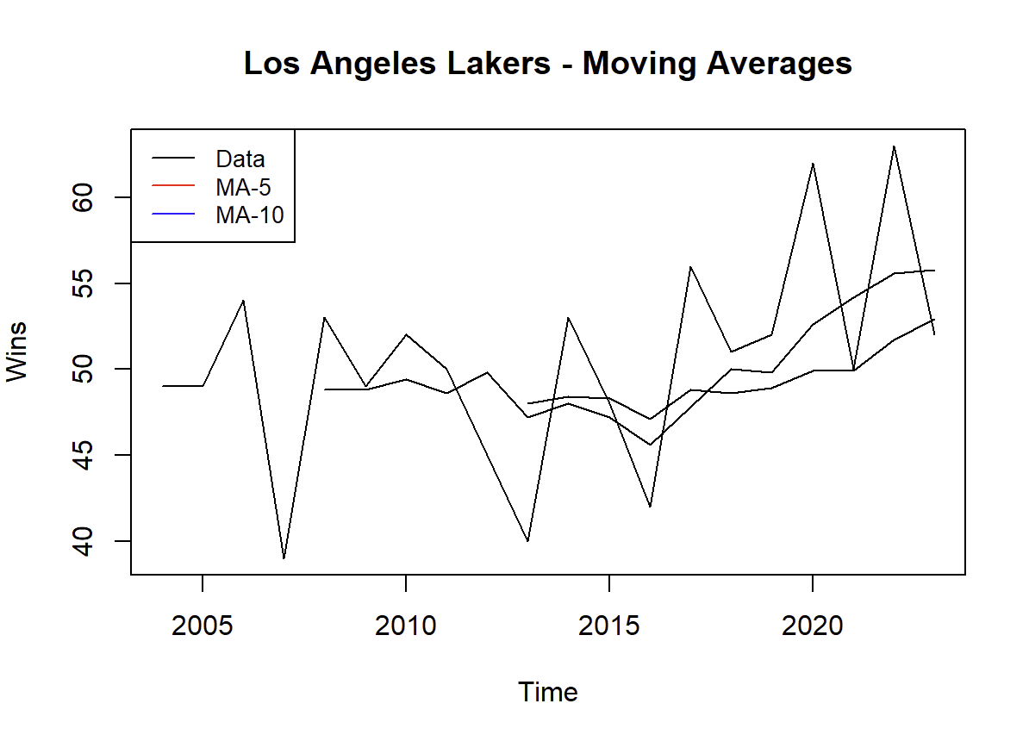
Applying Time Series + Moving Averages + Exponential Smoothing+Forecasting
Steps Taken:
Converted data to time series format.
Applied moving average smoothing (different window sizes).
Applied the exponential smoothing model.
Time series plot:
Moving Average Result:
MA-5 Errors: MSE MAD MAPE 1 36.58133 4.746667 9.203147
MA-10 Errors: MSE MAD MAPE 1 50.378 5.28 9.471195

Slide 13
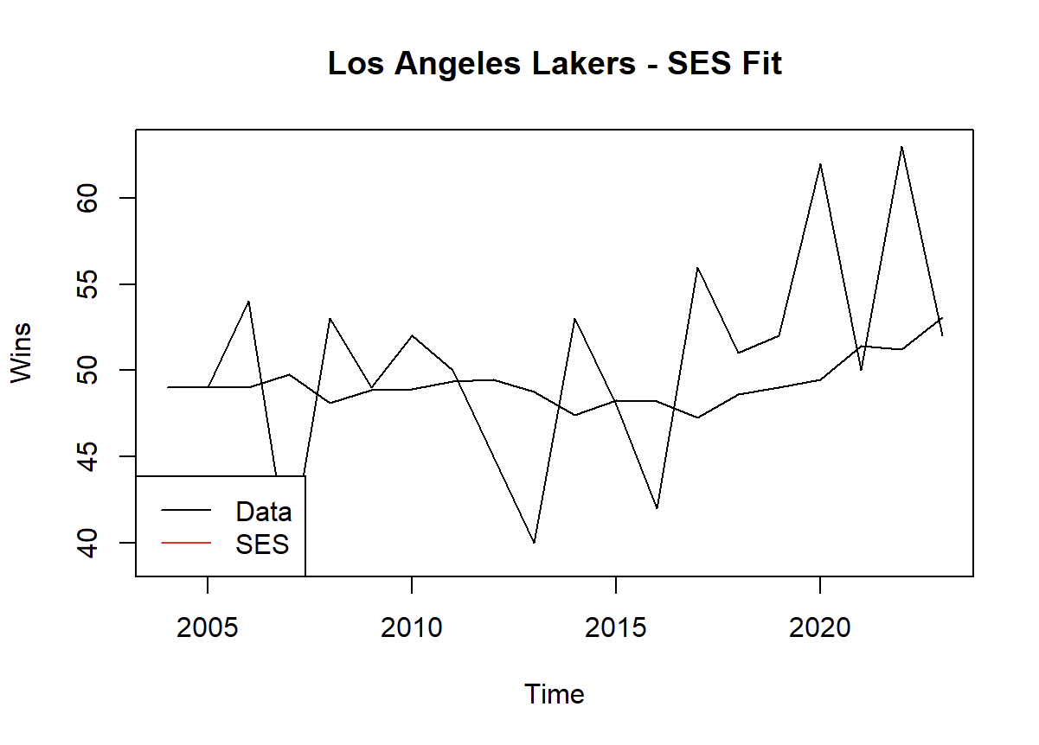
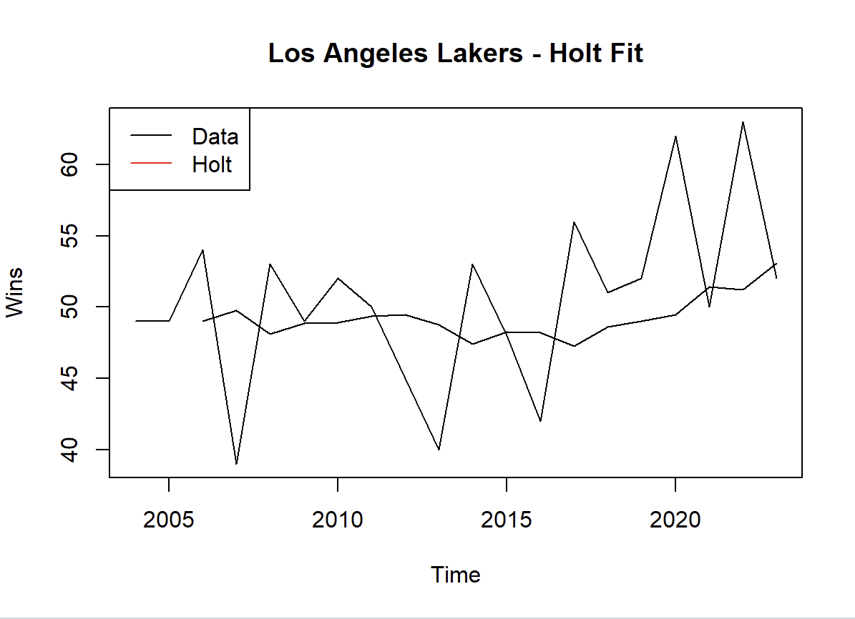
Exponential Smoothing (SES + Holt)
Holt Fit: Captures the upward trend in recent years better, adjusting for both level and trend in the data.
SES Fit: Produces a flatter line since it only considers level, missing the trend present in later years.

Slide 14
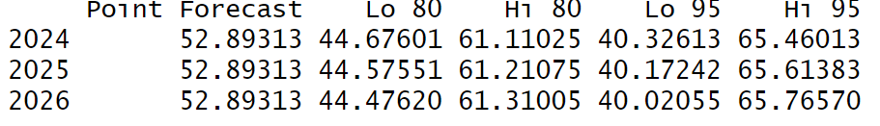
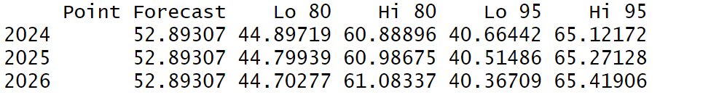
3-year forecasts
Holt forecast
SES forecast
The Holt model forecasts about 52.9 wins for the Lakers each year from 2024–2026, with an 80% confidence interval of roughly 44–61 wins and a 95% interval of 40–66 wins. The error metrics (RMSE ≈ 6.38, MAPE ≈ 10.1%) suggest a reasonably accurate fit with low bias (ME ≈ 1.38).
The SES model predicts around 52.89 wins for the Lakers each year from 2024–2026, with narrow confidence intervals (Lo 95% ≈ 40.37, Hi 95% ≈ 65.42). The error metrics show low MAE (4.78) and MAPE (~9.55%), indicating good accuracy, with a slightly better fit than Holt.

Slide 15

Conclusion
Two-Way ANOVA revealed significant differences between groups.
Chi-Square test identified [whether there was a relationship between variables].
Time Series analysis revealed clear trends and patterns for forecasting.
These statistical methods provided valuable insights into the dataset.

Slide 16

Thank You

